Slide 1
An Evidence-Based Approach to Concussion Care: Using Physiology to Advance Clinical Practice
Elizabeth Teel, PhD
Postdoctoral Fellow, McGill University
Research Associate, McGill University Health Centre

Slide 2
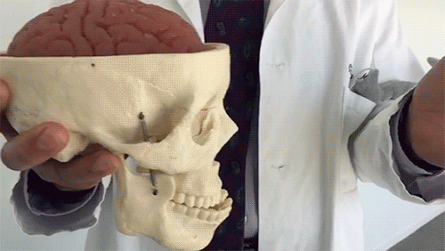
Concussion is a traumatic brain injury induced by biomechanical forces to the head or body, which results in pathophysiological changes.
TBI
Mild
Severe
Concussion
Notes:
Concussion is a Blow to head or body- cause the brain to move around in the skull
Shear forces cause axons to stretch, leading to neurochemical and neurophysiological changes.

Slide 3


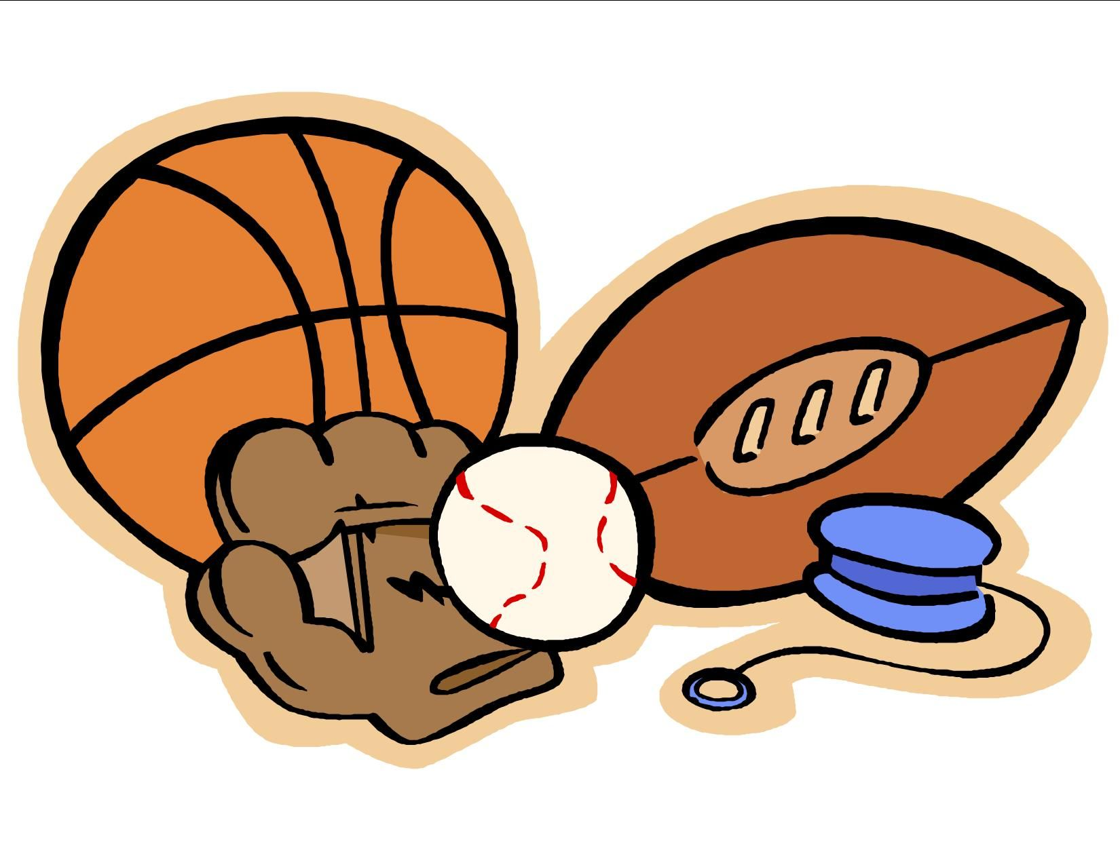
Concussion is a significant public health concern in North America, resulting in 1 in every 70 (Canada) or 220 (US) visits to pediatric emergency rooms annually.
Quality of Life
Notes:
miss days of school,³ experience emotional distress,⁴ and report reduced quality of life,

Slide 4
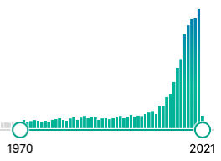
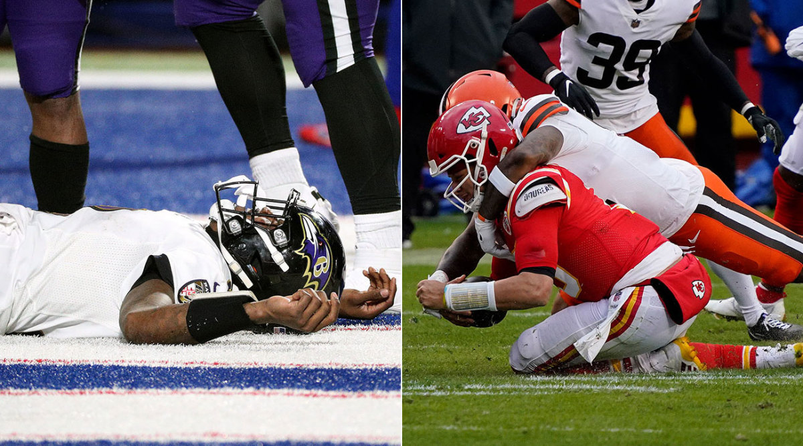
Concussion research remains in its infancy, with most of the literature published from the early 2000’s onward.

Slide 5

Current best practice for concussion diagnosis includes symptom, balance, and cognitive assessments.
Symptoms
Cognitive
Vestibular/Balance Sleep/Fatigue
Ocular
Migraine
Cervical Spine
Anxiety/Mood
Symptom Checklist
ImPACT, CNS Vital Signs, SAC
BESS, BOT, Tandem Gait
PSQI, ESS, Sleep Diary
VOMS, Eye Tracking
HIQ
Physical Assessment
GAD-7, PHQ-9
Notes:
Appropriate diagnosing when a concussion has occurred is the key first step to ensure a positive outcome for the injured person.
Concussion results in a number of symptoms and functional deficits
Number of assessments to measure each domain
However, currently symptoms, cognition, and balance are the only outcomes with widespread assessment during concussion
-What NCAA other sport orgs. Require→ non mandated domains really get evaluated

Slide 6
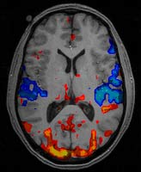

Current concussion diagnostic tools are limited by numerous factors and do not evaluate neurophysiology.
Practice/learning effects
Poor reliability
Low sensitivity/specificity
Participant manipulation
Sandbagging
Effort
EEG is a novel way to assess for concussion, addresses the majority of limitations present with current diagnostic tools, and measures underlying neurophysiology as opposed to functional deficits.
Erdal et al. 2012; Valovich et al. 2003; Slobounov et al. 2012

Slide 7
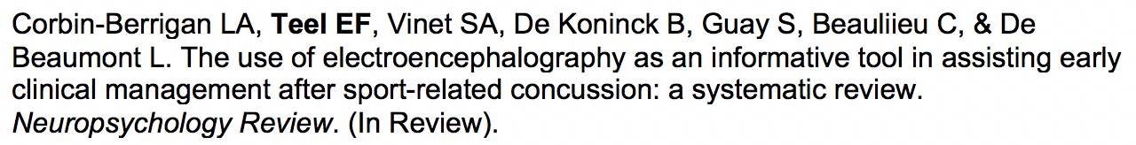
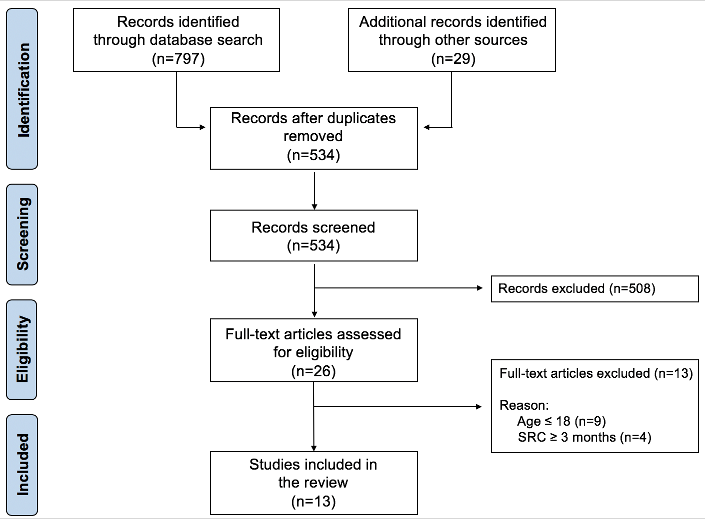
Which EEG measure is most indicative of clinical presentation?
Relationships between EEG outcomes and symptom, cognitive, and balance assessments were also observed, but there was no consistency across studies.
Can EEG metrics assist diagnosis and management of SRC in its acute phase?
The results of this review suggest that EEG can detect abnormalities during the acute post-injury period, but these indices have not been anchored in clinically relevant time points or clearly associated with clinical outcomes.
Notes:
We preformed a systematic review to better understand the literature surrounding the use of EEG in the clinical management of concussion.
Adults with concussion who had an EEG performed within the first 3 months post-injury
Only 5 of the 13 directly linked EEG outcomes to clinical outcomes- some relationships b/w EEG and clinical outcomes existed- but no consistent across studies
My research line aims to directly address the critical knowledge gaps identified in this literature review

Slide 8
Research Line 1: To use electroencephalography (EEG) to elucidate novel biomarkers of concussion and understand the electrophysiological basis of clinical impairments.
Past
Current
Future
EEG and Clinical Assessments
Psychometric Properties of EEG
Optimal EEG Biomarker for Concussion
Natural History of EEG Biomarkers following Concussion

Slide 9
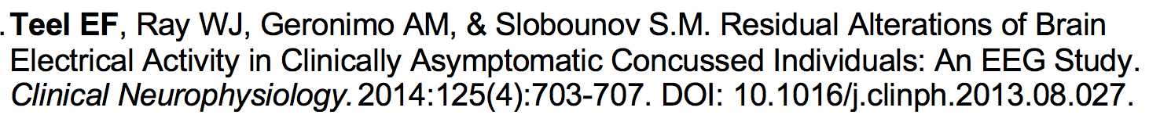

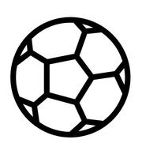

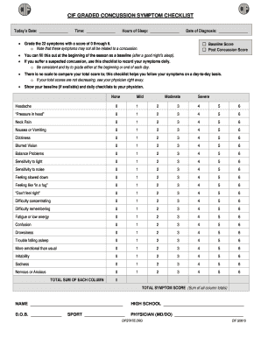
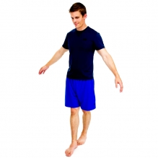
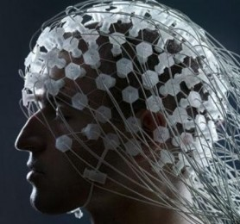

Purpose: To determine if EEG, cognitive, and balance outcomes differ between recently concussed participants and healthy volunteers.
Past
Notes:
My first concussion/EEG study evaluated individuals within 10 days of injury, but who were asymptomatic and fully returned to sport. So by clinical definition, these individuals were considered fully recovered.
Adults, varsity athletes, laboratory setting
Case/control study- looked at concussed individuals within 10 days of injury
-All were asymptomatic and cleared for full athletic participation at the time of the event
Individuals completed a resting-state EEG, followed by traditional clinical tests, including self-reported symptom checklists, computerized neurocognitive testing, and a balance paradigm.

Slide 10
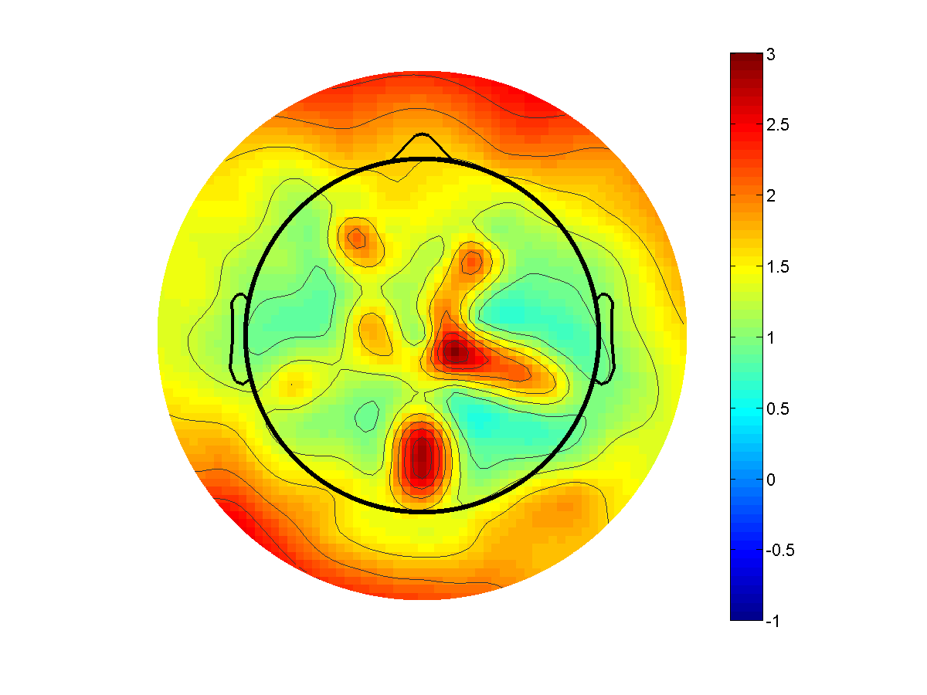
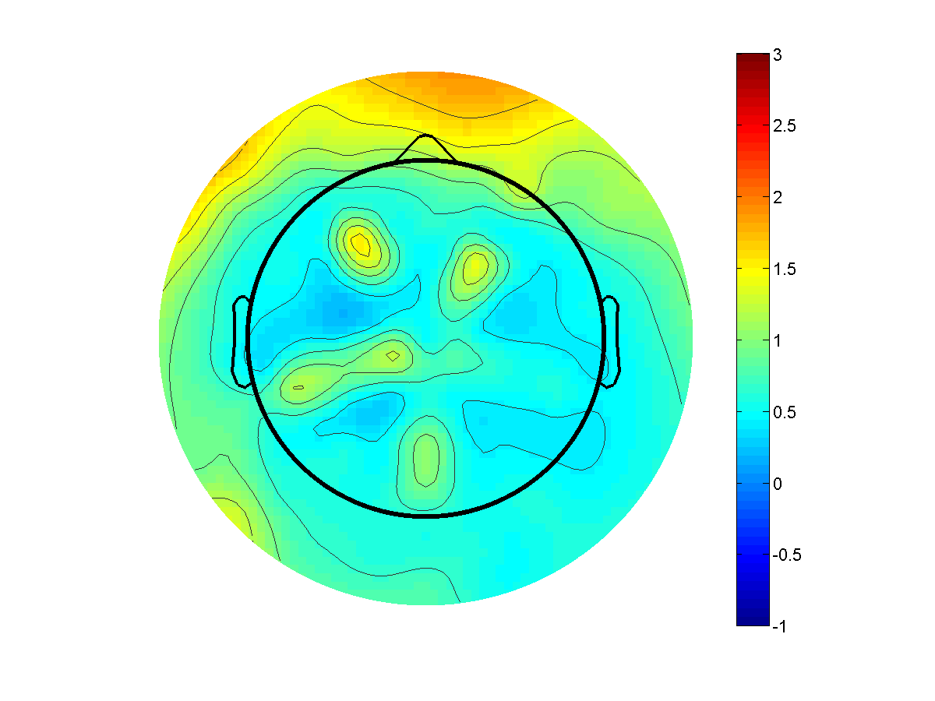
Recently concussed patients showed differences in EEG outcomes compared to healthy volunteers, despite equivalent performance during clinical testing.
Power
Coherence
Control
Concussed
Past
Notes:
No differences in clinical outcomes- expected as concussed patients were fully RTP at time of testing.
Topographic map represent EEG power- which is a functional of the amplitude of the EEG signal.
-More basically, power can be thought of the as the amount of neural activity.
-Concussed patients had significantly less power than healthy controls as visualized by the cooler topographic map.
Coherence evaluates how similar the EEG signal is between different electrodes of regions of the brain- in this case, we look at frontal, central, and posterior regions in the L and R hemisphere.
-Coherence can be thought of as communication, areas with higher coherence are thought to be working together while areas with lower coherence are not talking to each other.
-The concussed group showed significantly (p<.05) higher coherence between the ROIs highlighted in red.
Our results suggest that concussed participations may be using a compensatory mechanism to achieve normal cognitive/balance outcomes- essentially, the regions of the brain responsible for completing a task didn’t have enough neural activity to get the job done, so it recruited additional areas to help complete the task.
-This method is less efficient and may deteriorate over time- especially as individuals age and cognitive reserve decreases.
The Fourier decomposes the EEG time series into a "power spectrum", with power being the square of of the integral average of the amplitude of the EEG signal.
In more basic terms, power can be thought of as the amount of neural activity→ the higher the power, more activity.
Coherence is one mathematical method that can be used to determine if two or more sensors, or brain regions, have similar neuronal oscillatory activity with each other.

Slide 11
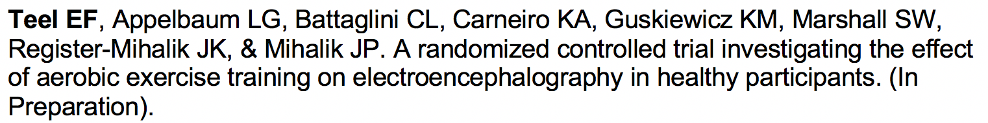
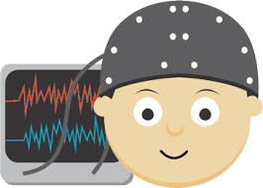

2-weeks
Purpose: To establish the test-retest reliability of EEG outcomes commonly used in the concussion literature over a clinically relevant time window.
Current
Notes:
As concussion management requires serial testing throughout recovery, it’s important that diagnostic assessments have appropriate levels of reliability across clinical relevant time points. Currently, I’m working on a study that assesses the test-retest reliability of a number of EEG outcomes commonly reported on in the brain injury literature.
HEALTHY ADULTS- no concussion within last year
Recreational athletes
Lab setting
The majority of adults with concussion will receive in 14 days, so we choose a two-week test-retest interval to mimic traditional recovery times in adult concussion.
**********************************
Fewer significant results were elicited during the eyes closed conditions, but this is in accordance with previous literature suggesting that large increases in alpha power during eyes closed conditions may mask other findings (Barry et al., 2007).

Slide 12
Psychometric soundness varies widely based on which EEG outcome, brain region, and condition (eyes open vs. eyes closed) is studied.
Current
Notes:
From this group of biomarkers, Alpha and alpha/theta ratio would be recommended for clinical use as they are the most reliable

Slide 13
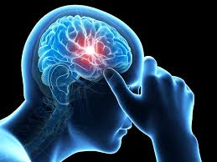
EEG can detect changes post-concussion and psychometric properties vary between outcomes. The optimal EEG measures for concussion diagnosis and management remain unknown.
What are the optimal (sensitivity/specificity) EEG biomarkers for concussion?
Do EEG biomarkers change over the course of clinical concussion recovery?
Do significant relationships exist between EEG biomarkers and clinical outcomes exist?
Future
Future
Notes:
My goal is to reduce the heterogeneity of this literature by providing reserachers with the optimal biomarkers and parameters to study in concussion indivdiuals. More specifically, I am to answer the following questions throughout this research line.

Slide 14
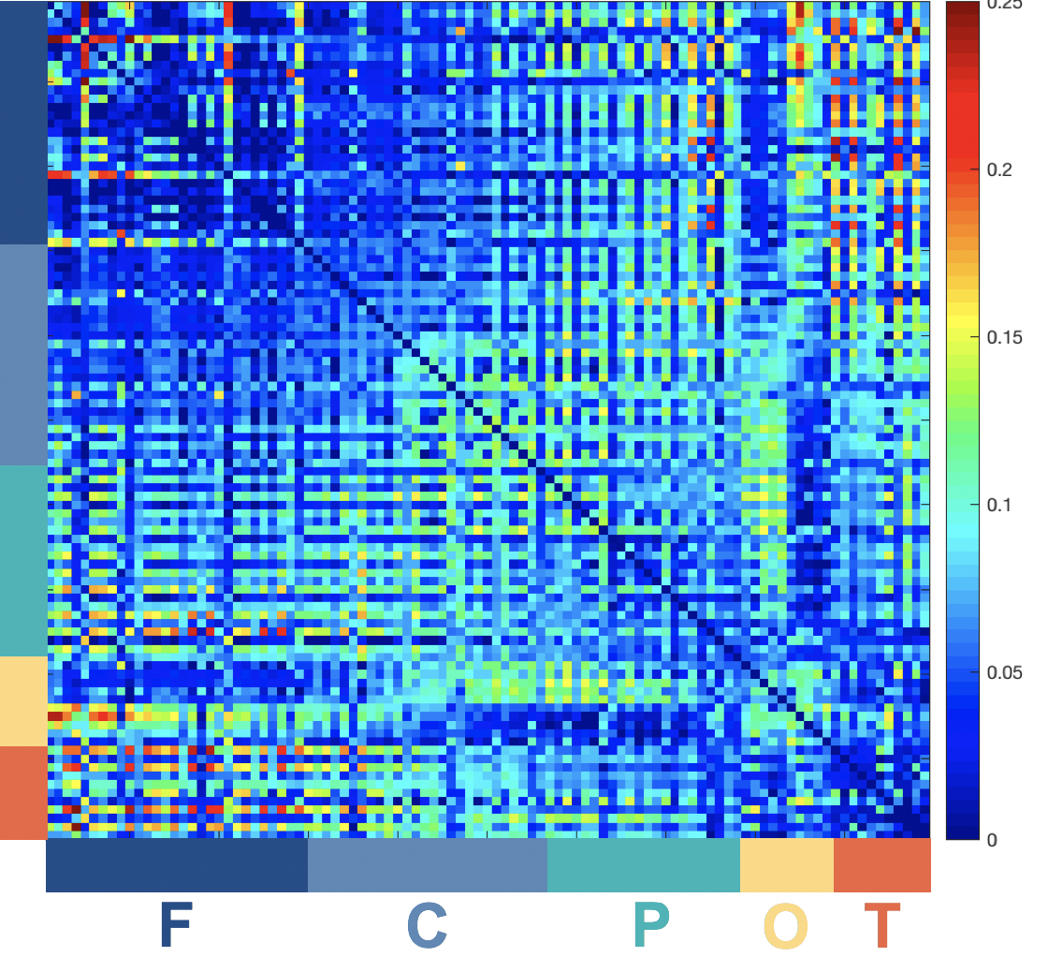
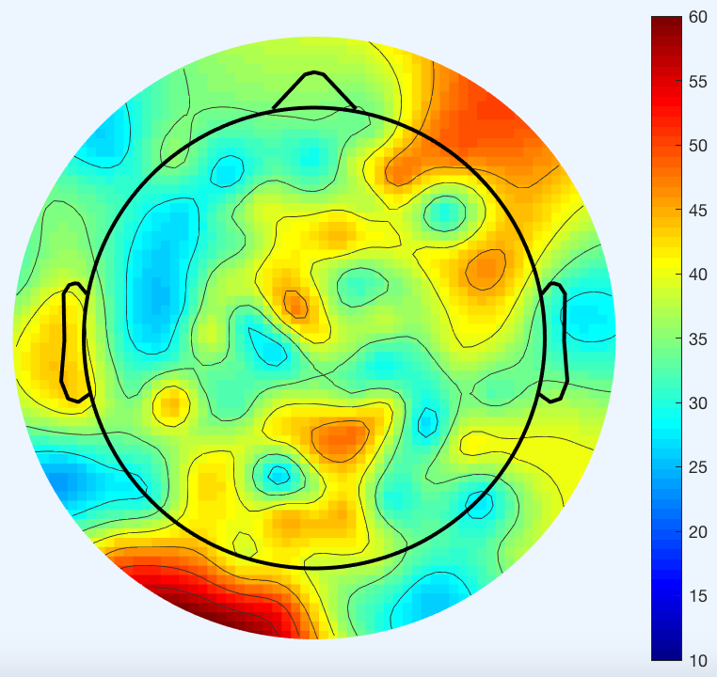
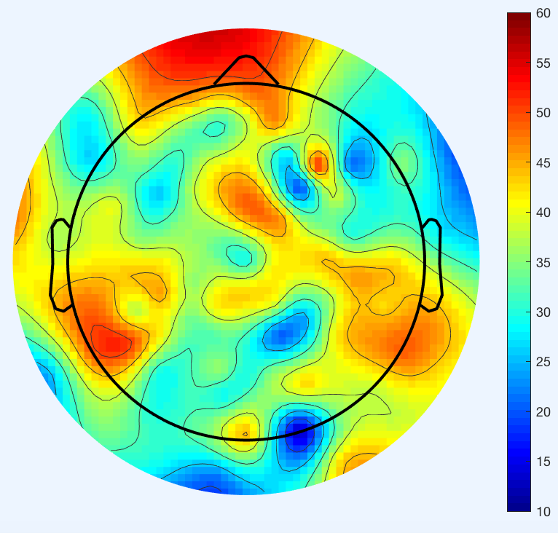
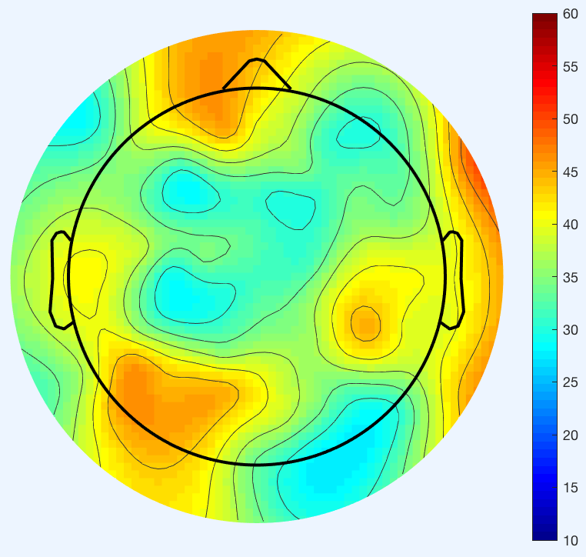
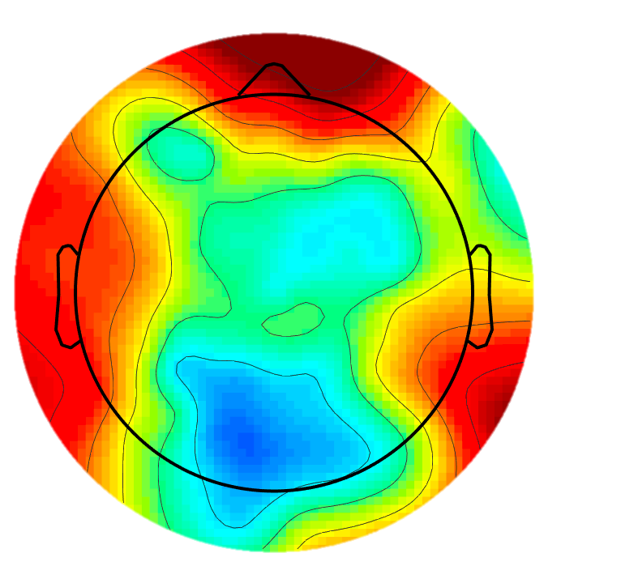
The goal of my postdoctoral work in the BIAPT lab is to enhance my EEG analytical skills, with a particular focus on functional connectivity measures.
Pre
Post
Anesthesia
Control
Notes:
EEG power, which was shown on the topographic maps in the last slide, is a type spectral analysis and the most commonly reported EEG outcomes in the concussion literature. Spectral analyses look at electrode as individual entities. So spectral analyses are likely to only pick up altered neural activity from areas where axons were injured and, if these areas are not close to the scalp, may not be able to identify any deficits at all.
Through post-synaptic terminals, a single neuron can have hundreds to thousands of connections with other axons. We also know that the brain is organized into functional networks and the networks are interconnected. So even if only a small number of axons are injured during a concussion, this can have a large, negative, downstream affects to communication throughout the brain.
Functional connectivity analyses looks at synchronization of neural activity across different electrodes or regions of the brain→ therefore, functional connectivity analysis may be more sensitive to concussion because they capture the disrupted communication among different networks in the brain.
Graph Theory Analysis- Degree of Nodes

Slide 15
Year 1
Year 2
Year 3
Year 4
Year 5
Concussion Biomarkers Over the First 6-Months Post-injury
The overall objective of this project is to determine the optimal EEG markers to observe electrophysiological changes following pediatric concussion and how these markers evolve over time and relate to clinical presentation.
Funding Sources:
CIHR Project Grant
CHIRP Grant
NIH K01
Study Preparation
(grant submission,
ethics approval, etc.)
In Progress
(data collection)
Study Termination
(data analysis/interpretation, manuscript submission)

Slide 16
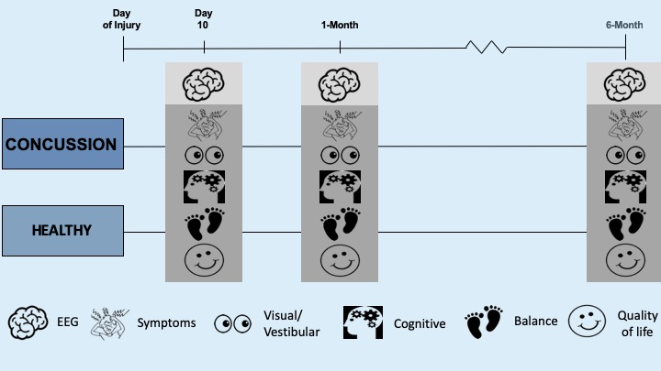
To determine if EEG may have clinical utility for concussion diagnosis, prognosis, and clinical recovery in adolescents.
Notes:
Expanded EEG outcomes form power/coherence to more sophisticated analyses, including PLI, dPLI, graph theory, and permutation entropy.

Slide 17
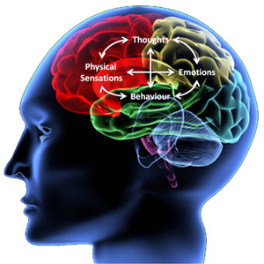
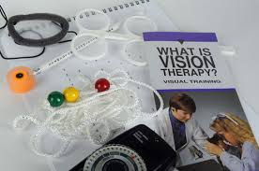
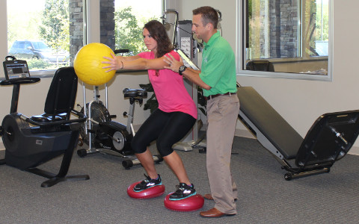
Research efforts have recently begin to focus on active treatments for concussion, with many avenues being explored.
Schneider et al. 2014; Alsalaheen et al. 2010; Thiagarajan et al. 2011/2013/2014a/2014b; Cicerone et al. 2002; Gagnon et al. 2009/2015
Notes:
Once a concussion is diagnosed, appropriate treatment can begin to facilitate recovery.
Cognitive, visual, vestibular, multi-modal

Slide 18

Notes:
However, the most widely implemented form of post-concussion rehabilitation is aerobic exercise.
Aerobic exercise has been consistently shown to improve recovery times, decrease post-concussion symptoms, and improve mood.
Exercise is Medicine® (EIM), a global health initiative managed by the American College of Sports Medicine (ACSM), encourages primary care physicians and other health care providers to include physical activity when designing treatment plans → fits this initiative and advances the evidence base to provide clinicians with better treatment options for patients
In addition, I believe that studying the effect of aerobic exercise intervention on recovery in individuals with concussion is well aligned with the School of Kinesiology’s mission to be an international leader in research related to physical activity and wellness

Slide 19
Research Line 2: To create active rehabilitation programs that eliminate acute clinical and physiological deficits & prevent prolonged recovery.
Past
Current
Future
ACTIVE Training
in Healthy Participants
EEG and Active Rehabilitation
ACTIVE Training in Acute Concussion
Notes:
My work in concussion rehabilitation programs are centered around physical activity (as it targets many of the physiological and clinical domains that are impaired post-concussion)

Slide 20
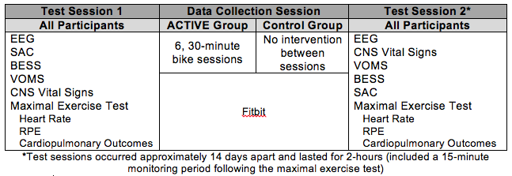
ACTIVE Training: Phase I RCT evaluating an aerobic exercise intervention in healthy participants
Mode: Cycling
Frequency: 3x/week
Duration: 30 minutes
Intensity: Progressive
60-80% of peak
oxygen consumption
Fitbit
Past
Notes:
I sought to design a program an aerobic exercise protocol that was capable in being employed in acute and chronic settings, and was feasible in a wide variety of populations. So, I created the ACTIVE training protocol for my doctoral dissertation.
INTERDISCIPLINARY COLLABORATIONS BETWEEN CONCUSSION EXPERTS/CLINICIANS (ATS AND MD), EXERCISE PHYSIOLOGISTS, COGNITIVE NEUROSCIENTIST, AND EPIDEMIOLOGIST
2 weeks between test sessions→ mimics average recovery times in adults
All Healthy participants

Slide 21
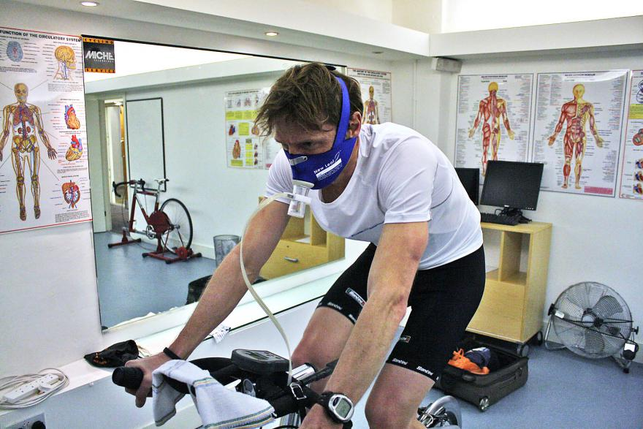
ACTIVE Training: Phase I RCT evaluating an aerobic exercise intervention in healthy participants
Purpose: To evaluate the effect of acute concussion therapy intervention (ACTIVE) training on clinical and physiological outcomes in healthy, college-aged participants.
Past
Notes:
2 weeks between test sessions
All Healthy participants

Slide 22
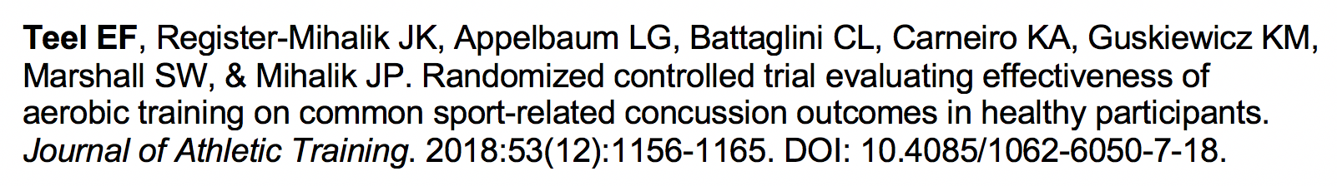
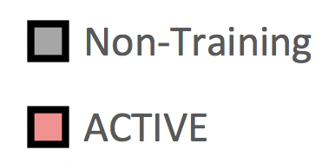
ACTIVE Training does not significantly alter performance on clinical concussion outcomes in healthy participants
Change Score
SAC
BESS
VOMS
GSC
Past
Notes:
When designing interventions, it’s important to assess if our treatment affects the tools we use to return athletes back to sport. This manuscript investigated the effect of ACTIVE training on clinical concussion management tools.
We looked at cognitive, balance, vision, and symptom tools.
ACTIVE training had no significant effect on any outcomes→ this aerobic exercise protocol will not elevate performance on these outcomes. If concussed patients show improvements following ACTIVE training, it would be indicative of recovery and not an unintended consequence of the protocol.

Slide 23
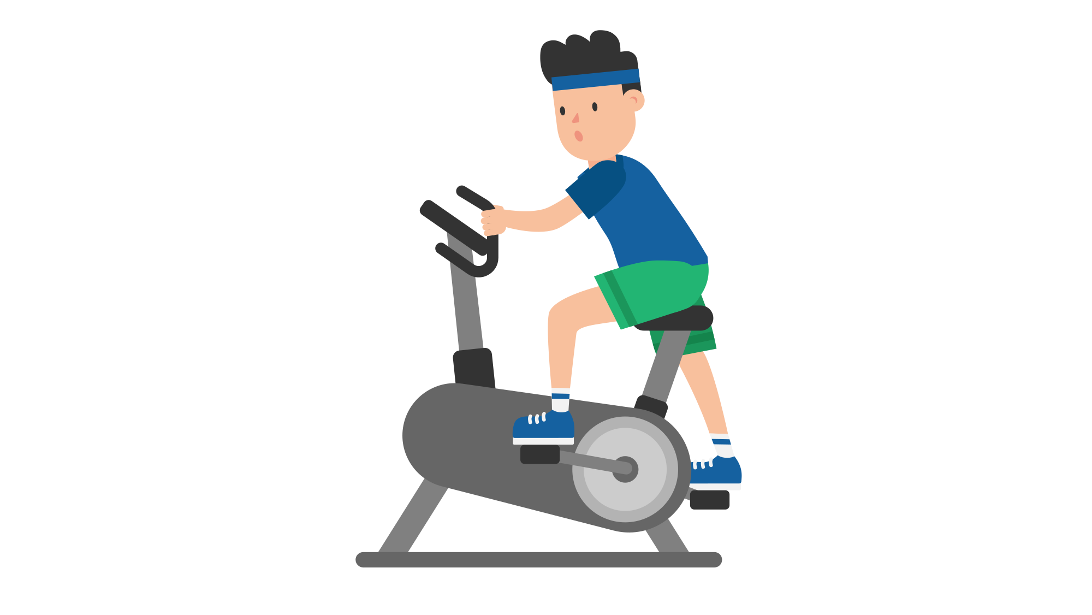
EEG can be used to assess the neurophysiological effects of post-concussion rehabilitation interventions.
Notes:
Interventions should not only strive to improve functional outcomes, but to improve the physiological deficits that underlie clinical presentation.
Although I have talked about them as separate entities, EEG and intervention work can be integrated into cohesive studies.
More specifically, EEG can be used to assess whether exercise based interventions successfully improve neurophysiological dysfunction.

Slide 24
Control: r=0.07, p=0.79 ACTIVE: r=0.42, p=0.07
Current
Notes:
EEG can be used as a way to assess of the neurophysiological consequences of an exercise based intervention.
Individuals in the ACTIVE training group had significantly increased central alpha power following the intervention, while the control group showed no changes in EEG outcomes.
The literature in healthy subjects shows that central alpha power is related to mood outcomes. We collected the GAD-7 (self-reported anxiety scale) during out study and attempted to correlate this. Outcomes.
Explain axes-
X is change in GAD-7→ the more negative the better
Y is change in mean alpha power→ the higher the better
There is a moderate correlation between central alpha power and self-reported anxiety- not powered for this finding, but an interesting relationship which I will explain in more detail in future studies.
This slide is probably the most critical in my talk- shows the ability to integrate EEG, clinical outcomes, and the rehab piece into one cohesive entity.

Slide 25
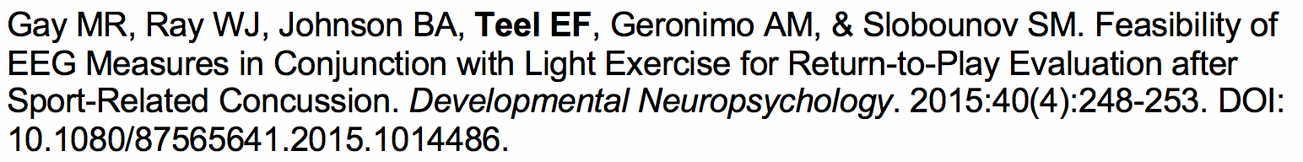
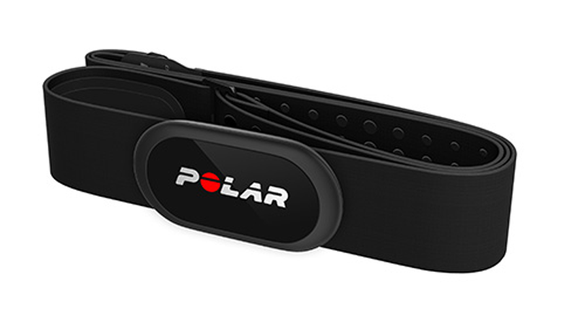
Purpose: To measure the effects of exercise on EEG power in recently concussed participants and age and sex-matched volunteers.
Past
Notes:
Developmental Neuropsychology

Slide 26
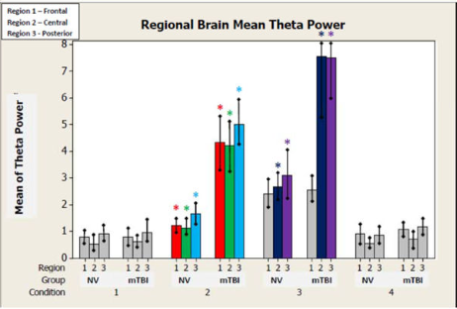
Concussed individuals have significantly higher theta power during and immediately following exercise.
Condition 1- Pre-Bike (rest)
Condition 2- During Bike
Condition 3- Immediate Post-Bike
Condition 4- 24hrs Post-Bike (rest)
We hypothesize that increased theta power in the concussed group during exercise may be related to reduced cortical blood flow and oxygen metabolism.
Past
Notes:
The YMCA Bike protocol was capable of inducing comparable changes to each subjects’ heart rate during the 4 stages of the bike test. There were no differences between the two group’s heart rates (p> 0.05). No subjects experienced any post-concussion symptoms
Statistical analysis revealed significant differences in whole brain Alpha (f(12)= 5.79; p = 0.001); Beta (f(11)= 4.49; p = 0.004); Delta (f(8) = 4.95; p = 0.002); and Theta (f(10) = 7.36; p = 0.000) power means between groups across two conditions (Bike, 30 min Post-Bike)
Theta power increases potentially stem from injury and pathophysiologic changes in the cerebral cortex (Montgomery, 1991). In work by Nagata, his group demonstrated that cortical blood flow (CBF) and oxygen (O2) metabolism correlated negatively with Delta and Theta power (Nagata, 1990). In addition, increases in Theta power have long been established in the mTBI literature (McClelland, 1994; Fenton, 1996) and are indicative of pathology.

Slide 27
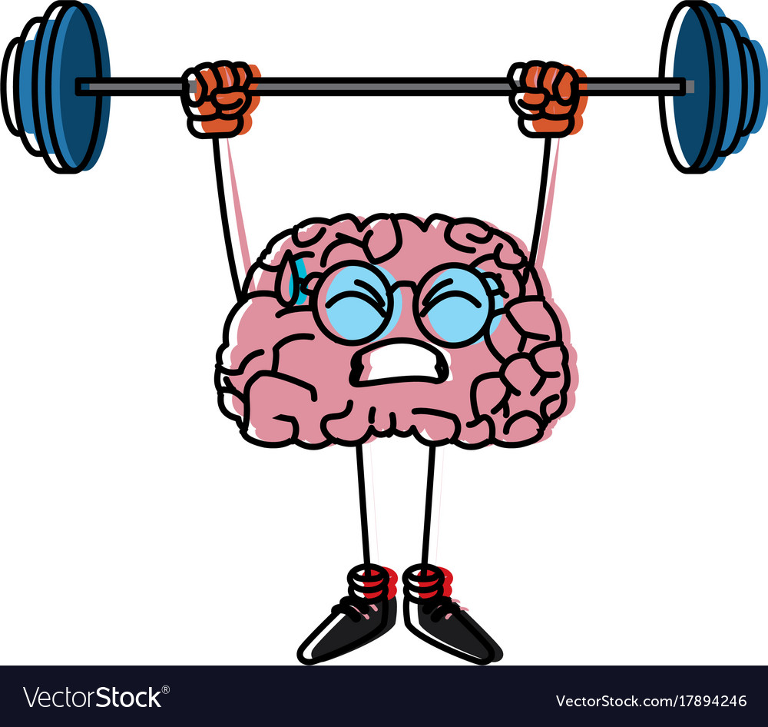
Active post-concussion rehabilitation interventions can have large clinical benefits, especially in individuals at high-risk of prolonged recovery.
What are the optimal exercise parameters for concussion rehabilitation?
How do active rehabilitation programs influence underlying physiology
in individuals with concussion?
What other domains (vision, dual-task, neuromuscular training, etc.) can be added to concussion rehabilitation programs to maximize both clinical and physiological recovery?
Can rehabilitation programs reduce future injury
risk (recurrent concussion and lower extremity)?
Future
Notes:
I believe that using interventions that target physiological domains can have high clinical impact, especially for individuals at high-risk of prolonged concussion recovery. However, a number of areas in this area need to be explored, which I plan to do in my future research line. Specific questions of interest include:

Slide 28
Year 1
Year 2
Year 3
Year 4
Year 5
The Safety & Feasibility of Active Rehab for Acute Concussion
The Effectiveness of Active Rehab on Clinical and Physiological Outcomes
Funding Sources:
NATA
NIH R21/R01
DoD
NOCSAE
Study Preparation
(grant submission,
ethics approval, etc.)
In Progress
(data collection)
Study Termination
(data analysis/interpretation, manuscript submission)
Notes:
Multi-modal research programs require interdisciplinary teams

Slide 29
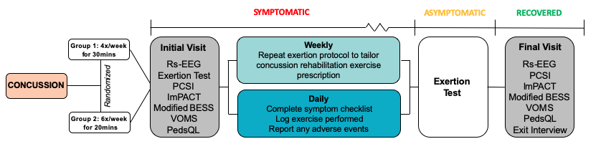
To compare the safety and feasibility of two aerobic exercise-based active rehabilitation programs
for children and adolescents with acute concussion.
To compare the effect of two aerobic exercise-based active rehabilitation programs on clinical and
electrophysiological outcomes for children and adolescents with acute concussion.

Slide 30
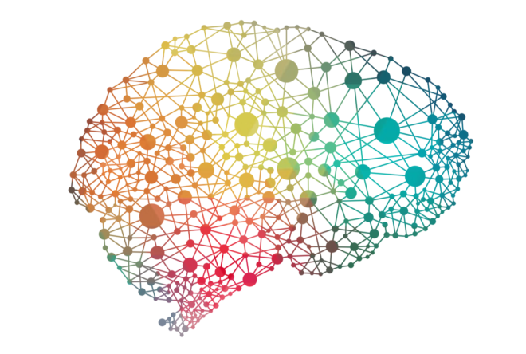
EEG can detect neurophysiological alterations in individuals with concussion and shows potential as a biomarker of injury.
Biomarkers
Cervical Spine
Outcomes
Event-Related
Potentials
Head Impact Biomechanics
Notes:
Current diagnostic tools are limited by a number of factors and fail to measure neurophysiological changes.
Researchers at the Michigan Concussion Center have investigated several tools for their potential in concussion diagnosis, including blood biomarkers, head impact biomechanics, and cervical spine outcomes.
I will use resting-state EEG to expand this on-going work to functional connectivity analyses, in hopes of finding a novel biomarker of injury.
In addition, the relationship between EEG outcomes and clinical sport-related concussion outcomes is virtually unexplored. In healthy patients, EEG components have been linked to cognitive, balance, and mental health assessments and similar relationships may exist in patients with concussion. Therefore, EEG may not only be able to aid in diagnosis, but also provide prognostic information about the type of deficits a patient may experience, which may facilitate earlier entry into rehabilitation protocols.

Slide 31
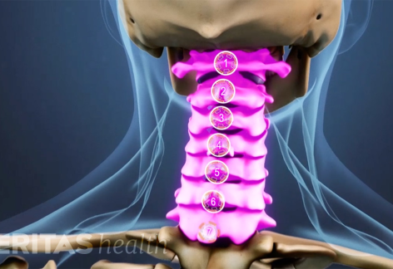
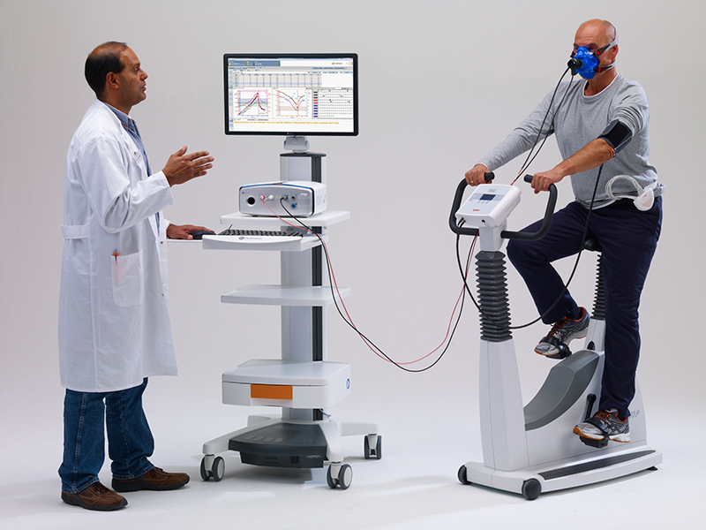
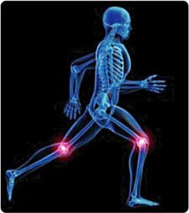
Active rehabilitation can improve recovery times and functional outcomes following concussion, but studies often focus on one mode of treatment and are of low quality.
Clinicians
(ATs, PTs, MDs)
Kinesiology
Multi-modal Rehabilitation Interventions for Individuals with Concussion
Notes:
Current concussion rehabilitation studies often focus on one mode of treatment, are of low quality, and only consider the intervention’s effect on clinical outcomes.
The Michigan Concussion Center and School of Kinesiology are home to world-renown experts in their respective fields. I am uniquely positioned to connect and apply the expertise and resources across these disciplines to create innovative multi-modal rehabilitation interventions to enhance recovery and improve quality of life for individuals with concussion.
My work seeks to leverage the clinical expertise in the Concussion Center regarding cervicogenic, visual, and vestibular interventions and in the School of Kinesiology regarding physical activity intervention, exercise prescription, and developing programs to prevent lower extremity injury risk.
This multidisciplinary approach will advance the quality and specificity of rehabilitation interventions offered by the clinicians in the Concussion Center and expand the on-going physical activity and lower extremity intervention work in the School of Kinesiology to a new population: concussed participants.

Slide 32
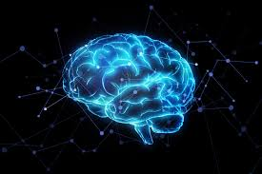

Additionally, my innovative research agenda will use EEG to understand the electrophysiological changes underlying intervention effectiveness.
Notes:
Understanding the physiological behind clinical performance and recovery can help clinicians design more effective interventions in the future.

Slide 33
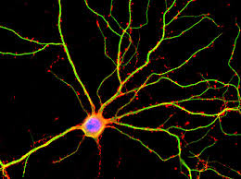

My research agenda spans clinical concussion diagnosis and management, advancing the current literature by adding novel methodology and assessments.
Notes:
I believe that by evaluating and integrating clinical and physiological outcomes, we can improve concussion diagnosis and management that will directly improve recovery and quality of life at the level of the individual. By engaging and translating knowledge to relevant stakeholders, as well as disseminating findings nationally and internationally, we can advance the current evidence base and improve outcomes for the entire population of concussed individuals.
Therefore, I believe this research agenda is well aligned with the Michigan Concussion Center’s mission to maximize societal and individual health.

Slide 34
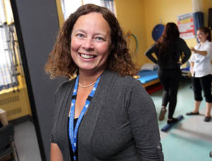

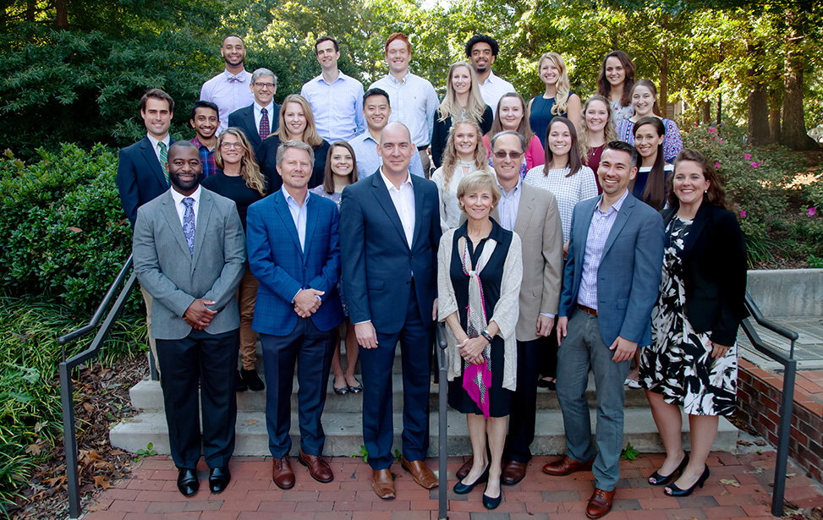
Acknowledgements
Staff & Clinicians:
Lisa Grilli
Debbie Schitzman
Christine Beaulieu, PT
Carlo Galli, PT
Meghan Straub, PT
Research Grants:
American College of Sports Medicine
Fonds de Recherche du Québec- Santé
The Graduate School at UNC
National Athletic Trainer’s Associate REF
Research Institute at MUHC
Réseau Provincial de Recherche
Notes:
Diverse group individuals, both in terms of background and expertise. My ability to implement an interdisciplinary approach to concussion research is largely a byproduct of training in such a stellar environment.

Slide 35



elizabeth.teel@mail.mcgill.ca
@eliz_teel

Slide 36




Diagnosis: Research Plan Years 5-10
Notes:
Reduce the number of electrodes needed to create an easier to use, more clinically applicable assessment tool
If we can eludicate EEG biomarkers of concussion, create a software program that automates processing and analysis on these outcomes--> again, increased the clinical utility of these programs
EEG biofeedback- can we use it as a form of rehabilitation?
Long-term vs. short comes- are the same EEG outcomes that are identified acutely post-injury the same variables that are elevated years following injury

Slide 37
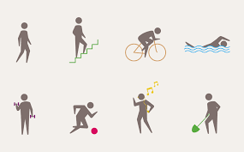


Management: Research Plan Years 5-10
Notes:
Manipulating exercise parameters (mode, intensity, frequency, duration) to find the optimize prescription to maximize clinical and physiological recovery from concussion
Creating a multi-modal program
-Calgary is already doing work in this area with cervicovestibular and aerobic exercise
-Vision training, neuromuscular training, dual-task paradigms
Create a registry/system to facilitate long-term (5+ year) follow- up of patients

Slide 38
Research Line 3: To improve sport safety through the development of innovative head trauma prevention programs that reduce initial concussion risk
Past
Current
Future
Determining optimal intervention point
Vision/sensor performance training
Multi-modal concussion prevention pilot
Vision/Sensory Performance in Helmeted Sports
Head Impact Biomechanics

Slide 39
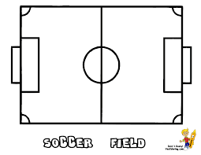

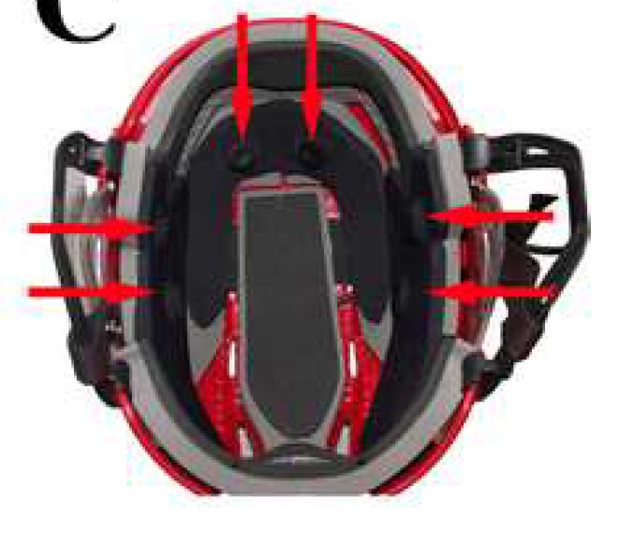

Purpose: To quantify sex differences in head impact frequency and severity sustained by youth ice hockey players.
Past
Notes:
While a biomechanical threshold for concussion remains elusive, it is generally accepted among researchers that more frequent and severe impacts increase risk of concussion and other negative outcomes. Therefore, using sensors that measuring head impact frequency and severity may useful strategy to gauge the effective of primary prevention programs alongside examining concussion incidence.
Bantam (13/14) and Midget (15/16) players

Slide 40
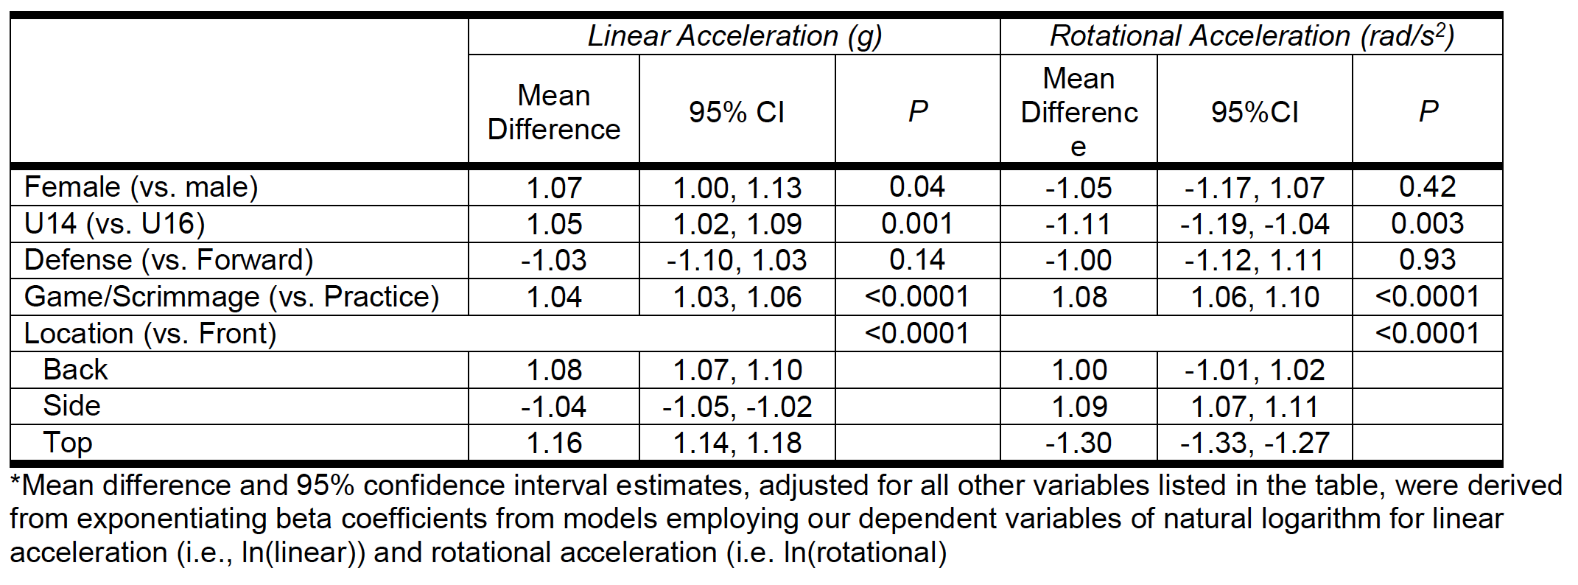
Female ice hockey players sustained fewer impacts than their male counterparts, but had higher mean linear accelerations.
Past
Notes:
Our main findings is that…
On the left, you’ll see our primary predictor (sex) and covariates entered into our random-intercepts mixed linear models.
As you can see, females had significantly higher mean linear accelerations than males, but not difference were noted for rotational acceleration. In large with agreement with previous
Body checking is illegal at all levels of female ice hockey, which likely accounts for the fewer number of impacts received. However, the fact that females were recorded with any impacts suggest that they were through illegal mechanisms, which may be more severe collisions or females may not be trained to absorb this impact as well as males, which may account for the slightly higher severity females experiences.

Slide 41

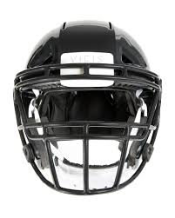
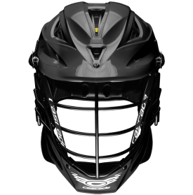


Purpose: To understand the effect of football, lacrosse, and ice hockey helmets on visual and sensory performance.
Past
Notes:
An important component of both athletic performance and athlete safety is the ability to see and respond to the environment. While sport helmets are critical for reducing severe brain injuries, the bars included as part of the helmets may alter an athletes visual and sensory performance. I served as the primary mentor on this undergraduate honor’s thesis project which evaluated the effect…
MENTORSHIP

Slide 42


Visual and sensory performance was worse under helmeted conditions, particularly for ice hockey players.
Past
Notes:
Our main findings…
When looking at sport by helmet interactions, we found that helmet players performed worse on visual clarity and hand reaction time with their helmets on. The reaction time performance was particularly notable and they performance approximately 36 seconds slower in the helmet, as compared to football players who performaned equivalently with their helmet on and lacrosse players who actually improved while wearing their helmet.

Slide 43
Visual and sensory performance was worse under helmeted conditions, particularly for ice hockey players.
Past
Notes:
When we consider the deisgn of each respective helmet, the hockey cage has a greater number of bars than the other helmets, especially across the eyes. We hypothesize that these bars as acting as visual distractors, which degrades performance.

Slide 44
Year 1
Year 2
Year 3
Year 4
Year 5
Identifying Targets Areas for Prevention in HS Athletics
Visual/Sensory Performance Training Programs
Multimodal Concussion Prevention Program in HS Athletes: A Pilot Study
Funding Sources:
NATA
NIH R03
CDC
Target Journals:
BJSM
Sports Medicine
Pediatrics
Study Preparation
(grant submission,
ethics approval, etc.)
In Progress
(data collection)
Study Termination
(data analysis/interpretation, manuscript submission)

Slide 45



Prevention: Research Plan Years 5-10
Notes:
Individualized- the current plan is at the team level-
-Identify participants most at risk of concussion based on their head impact biomechanics profile
-Work to with coaching and sports med (AT, strength/condition/etc). to develop specific plan for player -Additional work on a certain skill/technique, strengthening,
-Use video of player in poor technique/situations to as an education tool
-Based on BeMod
Sport specific prevention plans
-customize plans for different sports
Add in neuromuscular training components to expand injury prevention effectiveness beyond concussion

Slide 46

Loss of Consciousness (Y/N)
Amnesia (None, 0-30min, 30+min)
Concussion History (Y/N)
Purpose: To determine whether loss of consciousness (LOC), amnesia, and concussion history influence the acute recovery of symptom, cognitive, and balance outcomes.
Winner, 2017 Kenneth L. Knight Award
Journal of Athletic Training, Most Outstanding Manuscript
Past
Notes:
I sought to determine if there are any factors that are available to clinicians immediately (i.e. at the moment of injury) that can help them determine if an individual is at increased risk of concussion.
HS and college athletes. Field settings- on the sidelines, AT rooms
General linear models with random intercepts and random slopes with correction for first order autoregressive serial correction
Athletes were baseline tested then follow longitudinally. If concussed, they were tested again immediately post-injury, 3hrs post-injury, and 1, 3, 5, and 7 days post-injury.
SAC, BESS, and Symptom checklist were assessed

Slide 47


Concussion
Pre-Season
3-Hours
Day 1
Day 3
Day 5
Day 7
Day 90
Winner, 2017 Kenneth L. Knight Award
Journal of Athletic Training, Most Outstanding Manuscript
Past
Notes:
I sought to determine if there are any factors that are available to clinicians immediately (i.e. at the moment of injury) that can help them determine if an individual is at increased risk of concussion.
HS and college athletes. Field settings- on the sidelines, AT rooms
General linear models with random intercepts and random slopes with correction for first order autoregressive serial correction
Athletes were baseline tested then follow longitudinally. If concussed, they were tested again immediately post-injury, 3hrs post-injury, and 1, 3, 5, and 7 days post-injury.
SAC, BESS, and Symptom checklist were assessed

Slide 48

LOC, amnesia, and concussion history do not affect clinical recovery time.
There is no evidence to support more cautious return-to-play decisions for athletes with these characteristics.
Past
Notes:
Some minor findings were observed, but everything resolved by day 7 post-injury

Slide 49


Maximal exercise significantly increased S100B in all participants
S100B response to maximal exercise was variable among participants
ACTIVE training did not effect S100B outcomes
Current
Notes:
In addition to cardiopulmonary outcomes, we also looked at the affect of ACTIVE training on blood biomarkers before and after each maximal exercise test.
S100 calcium-binding protein B (S100B), has shown promise in concussion care, with the biomarker showing elevated responses acutely following injury (12, 13). The S100B is known to increase following a single bout of physical activity (14, 15), but no studies have evaluated how short-term exercise training may affect the biomarker’s presence.
S100B is a protein fond in various cells throughout the body, most notable for TBI in mature perivascular astrocytes

Slide 50


HR: F_{(5,101)}=4.57, p<0.001
RPE: F_{(5,95)}=2.11, p=0.07
Past

Slide 51
ACTIVE Training is a safe and feasible intervention that healthy participants adhere to.
Past

Slide 52



Patients traditionally were told to avoid exercise until symptoms subsided, but earlier resumption of physical activity is now considered best practice.
Notes:
Previous management stated that rest is best- no physical activity until all concussion symptoms and deficits were gone
Although aerobic exercise is not advocated, little research has guided the expert consensus that physical activity can resume 48 hours post-concussion. It is generally agreed that exercise too early can be determinal, but waiting too long can cause patients to unnecessary suffer for longer than needed. Questions are the optimal timing to introduce exercise following concussion remains and some of my postdoctoral works seeks to provide evidence in this area.

Slide 53




Active Rehabilitation Following Pediatric Concussion: Comparison of Time to Protocol Initiation
Aim 1. To what extent does active rehabilitation initiated early (two-weeks post-concussion) improve recovery time compared to active rehabilitation initiated at four or more weeks post-concussion?
Aim 2. To what extent does active rehabilitation initiated early reduce the likelihood of being diagnosed with persistent post-concussion symptoms (PPCS)?
Current
Notes:
Long-term goal w/ the ACTIVE rehab program I developed in my dissertation is create specific exercise prescription guidelines for individuals w/ concussion--> including the optimal timing, intensity, and duration of exercise
A second component of my postdoctoral training begins to investigate how the timing of rehabilitation initiation (i.e. length between injury and starting rehab) influences the length of rehabilitation services and the total recovery time
The concussion clinic at the montreal children’s hospital previous didn’t start active rehabilitation interventions (combine aerobic exercise with sport-specific drills) until 4 weeks following injury. Starting in 2017-2018 academic year, the clinic began starting active rehab at 2-weeks post-injury in compliance with updated best practice guidelines recommending earlier resumption of physical activity.
We are evaluating how this policy changes influenced clinical outcomes for children

Slide 54

Baseline
Asymptomatic
Injury
Full RTP
Concussed
Healthy
Notes:
Reliability is not enough. More importantly, EEG needs to be able to accuracy differentiate between injured subjects and healthy controls to have clinical utility.
Finding which EEG outcomes can accurately classify between concussed and control subject is vital to finding an EEG biomarker that can be used for clinical concussion diagnosis.

Slide 55



Slide 56

Optimal rehabilitation strategies can increase quality of life and reduce the risk of subsequent concussion and musculoskeletal injury.
Aerobic
Exercise
Cervical Spine
Rehabilitation
Vestibular
Rehabilitation
Visual
Rehabilitation
Notes:
Clinicians and researchers within the Concussion Center use a variety of rehabilitation approaches to improve quality of life in patients. Researchers in the School of Kinesiology additionally have expertise in intervention work, including aerobic exercise and lower extremity injury programs.
My research adds novel physiological outcomes measures to the ongoing concussion rehabilitation programs to better evaluate the effectiveness of these protocols.
I believe it is well aligned with the current work, equipment, and expertise within the School of Kinesiology and expands the critical work being done here to a new population: concussed patients. Additionally, this research line offers the opportunity for collaborations that can lead to highly novel and impact research in the field of post-concussion rehabilitation.

Slide 57


Improper diagnosis of concussion can lead to catastrophic injury, more severe symptoms, and longer recovery times.
Notes:
A proper concussion diagnosis is critical for athlete safety. Athletes who are not properly diagnosed are at risk for a variety of negative outcomes.
Even without catastrophic consequence, playing with a concussion increases the likelihood of more severe symptoms and deficits, and an overall longer recovery time.

Slide 58



To date, most concussion rehabilitation studies are of low quality, consider only clinical outcomes, and do not include long-term follow-up.
Notes:
A small but cohesive body of literature has suggested the rehabilitation protocols, particularly aerobic exercise, are effective in promoting concussion recovery.
Low quality- case studies, cohorts- very few RTCs
Clinical outcomes- visual, balance, symptoms→ do not elucidate the physiological mechanism for why these protocols are effective
Long-term- while the literature generally suggests patients recovery faster, there is no information to what happens to these patients once they are cleared for play. Do they have the same risk of recurrent concussion? What about their chances of musculoskletal injury, which has shown to be increased following a concussion?

Slide 59



Purpose: To understand the functional networks associated with cognitive performance and how these networks are influenced by emerging consciousness following anesthesia.
Notes:
Digit Symbol Substitution test. My rationale is that 1: this is a test that we use in concussed patients, so findings are somewhat translatable, 2. The control patient shows that although these systems are dynamic, the patterns of functional connectivity remain largely the same after repeat testing (which is important because concussion requires serially testing over time) and 3. The anesthesia patient shows that these analyses are sensitive to alternation in brain states, which I hope will show its potential for detecting alterations post-concussion.
Digit symbol/rationale for how this translate to concussion
Purpose statement for the images I’m showing

Slide 60




Children with concussion may need different interventions than adults patients.
Notes:
Most of my work is in adult and more specifically college athlete populations→ wanted to expand my skill set to other concussed populations, so I chose to do my postdoc at McGill where I work in a pediatric specialty concussion clinic
College athletes→ on campus, elite level athletes, used to playing sport and receiving treatment most days of the weeks
-interventions that require 5-6 days/week at a lab/clinical space may not be feasible for most children
One of the biggest differences in treating children is the role of the parent
-Driving/transportation to doctor
-Ensure rehab is performed at home
I wanted to investigate bi-directional relationships between parent and child- more specifically, do parents influence the way their child recovers from a concussion?

Slide 61




Parental Stress and Clinical Recovery Following Pediatric Concussion: A Mixed-Methods Study
Injury Factors
Non-Injury Factors
Caregiver Factors
Purpose: To understand a parent’s stress following their child’s concussion and to determine if parental stress influences clinical recovery time for the child.
Current
Notes:
Children across most MOIS- sports, car accidents, slips/falls (no intentional mechanisms- assault) in a clinical sports medicine settings
Cognitive appraisal of stress- depends on coping ability, perception of injury
-Parents will likely have different stress regarding their child’s concussion.
Previous literature in severe TBI and cancer showed that parents of sick children experience stress due to three main categories: injury, non-injury (other work/life stressors), and caregiver
We employed a number of surveys, including the Perceived Stress Scale time locked to the child’s concussion, and an 11-question semi-structured interview.

Slide 62

Higher levels of perceived parental stress are significantly related to longer recovery times for the concussed child, even when controlling for symptoms and parent-child closeness.
“I stress for her because I see her stress levels. Maybe we’re, maybe our stress is feeding… that’s part of why I’m trying to manage my own stress because I’m sure if she even senses any kind of me worrying about her or stress for her that that’s feeding into her own stress.”
Notes:
Children took longer to recover when their parents had higher perceived stress.
In the interview, several parents discussed the bi-directional relationship regarding stress with their child.

Slide 63

Avenues for post-concussion rehabilitation interventions are vast and multi-modal program may be ideal to facilitate recovery in individuals with concussion.
Notes:
Aerobic exercise will be the cornerstone of my post-concussion rehabilitation interventions, because it influences so many of the physiological (cerebral blood flow, autonomic nervous system) and clinical (cognitive, sleep, mood) deficits that patients experience post-concussion.
However, exercise alone may not be enough to eliminate all deficits for patients, therefore multi-modal interventions that combine exercise intervention with other forms of therapies will critical.
My work in parental stress suggests that educational interventions targeting the family may be of benefit. Concussed patients often experience visual/vestibular deficits after injury, and patients with concussion are more likely to experience lower extremity injuries following their concussions. Unfortunately I don’t have time to detail my work in these areas, particularly in visual and sensory performance, but these areas are also targets for future multi-modal interventions.

